Slide 1
Introduction to C++

Slide 2
Chapter 1 Introduction to Computer
Chapter 1 Section 1
Manually Operated Devices:
The abacus may have existed as early as the third century A.D. However, the Chinese perfected it in the 12th century.
Mechanical Devices:
In 1642, Blaise Pascal designed the first gear – driven counting machine. The machine can add and subtract by using a series of interlocking wheels and gears.
Electronic Computer:
1971 > The First microprocessor ( The Intel 4004)
1975 > The First microcomputer ( The Altair 8800)
1976 > Apple I appears and Apple Computer is founded
1977 > Apple II > Radio Shack TRS-80 Model I
1978 > Epson introduces the first affordable dot-matrix printer
1979 > Intel 8088 microprocessor (later used in the first IBM PC) > Motorola 68000 microprocessor (later used in the first Macintosh)
1980 > Commodore VIC-20 > Apple III > TRS-80 Color Computer
1981 > IBM PC > Hayes Smart modem 300
1982 > Intel 80286 microprocessor > Commodore 64
1983 > Apple Lisa > Apple II e > IBM PC Jr. > IBM PC/XT
1984 > Macintosh > Apple II c > IBM AT > Motorola 68020 microprocessor
1985 > Commodore Amiga 1000 > The first disk is made available for Macintosh computers
1986 > Intel 80386 microprocessor > Motorola 68030 microprocessor > Apple II gs
1987 > IBM PS/2
1989 > Intel 80486 microprocessor
1990 > Motorola 68040 microprocessor
1992 > Intel 80486-DX2 microprocessor
1993 > Intel Pentium microprocessor > PowerPC 601 microprocessor

Slide 3
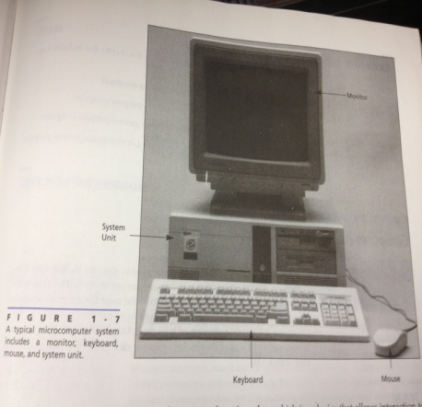
Chapter 1 introduction to Computer
Chapter 1 Section 2
System components:
The equipment that makes up the computer is called a hardware. Each piece of hardware is involved in one of the four tasks: input, output, processing or storage.
Input and Output:
All computers interact and this interaction are called input and output.
Modem: A device that allows interaction to occur between computers over the telephone, is capable of both input and output.
Processing and storage:
At the heart of the computer, the inputs are processed and stored, and output is created. This is accomplished using a variety of devices such as a microprocessor, RAM, ROM, a bus, and disk drives.

Slide 4
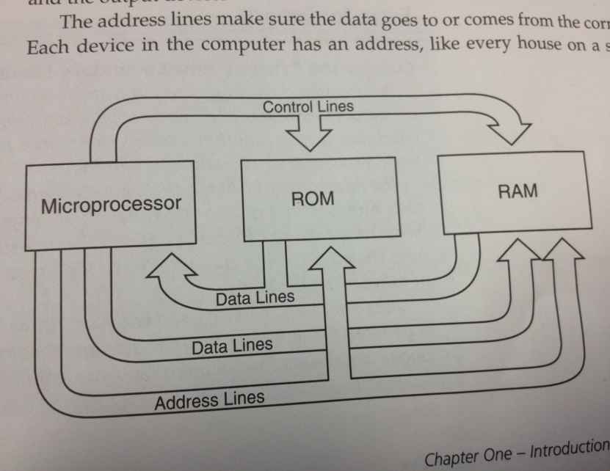
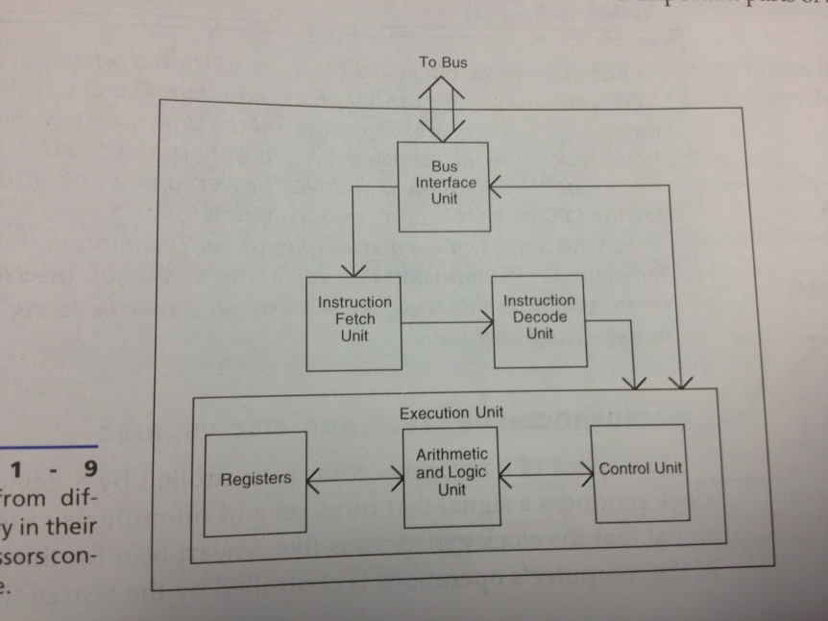
Chapter 1 Introduction to Computers
Chapter 1 Section 3
Computer Architecture:
RAM: is an acronym for Random access memory, is your computer’s primary storage
ROM: is an acronym for Read-Only memory. Your computer’s ROM is a set of memory chips that have data permanently stored upon them.
Taking the bus:
The microprocessor is connected to the RAM, ROM, and other devices by a system of wires called a bus.

Slide 5
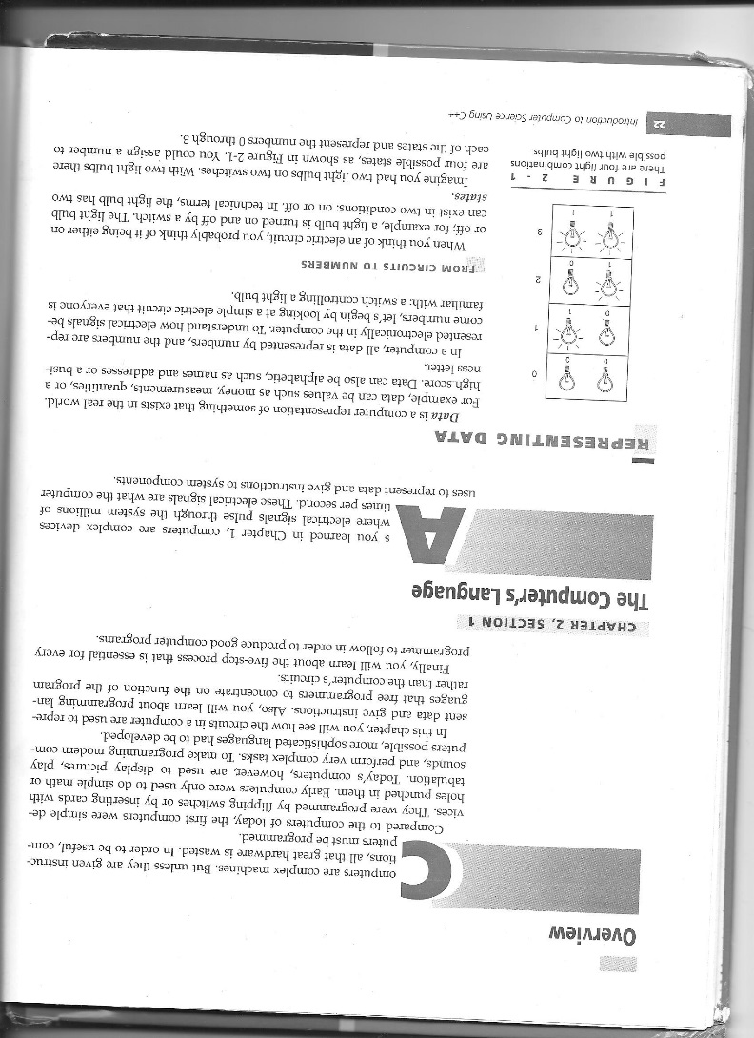
Chapter 2 How computers are programmed

Slide 6
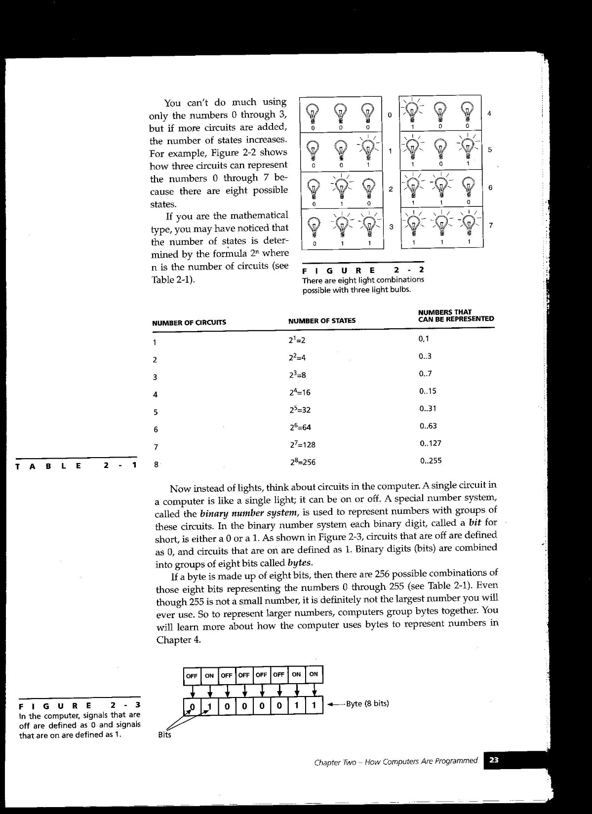

Slide 7
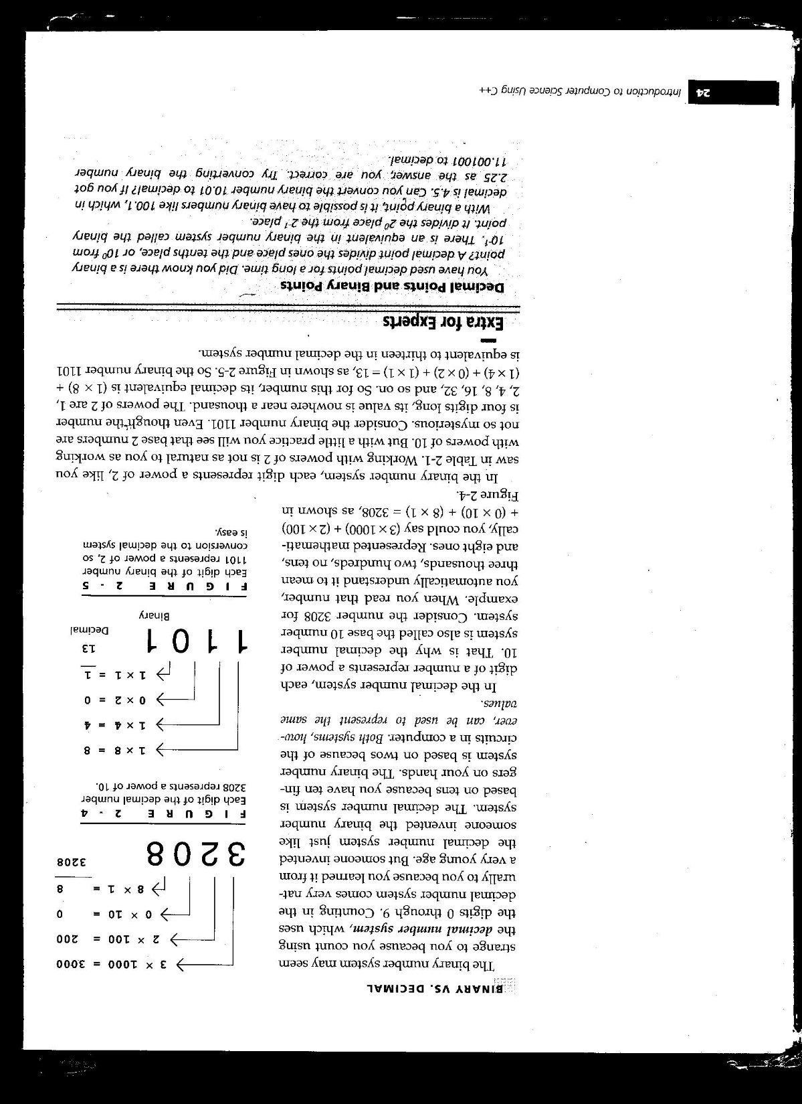

Slide 8
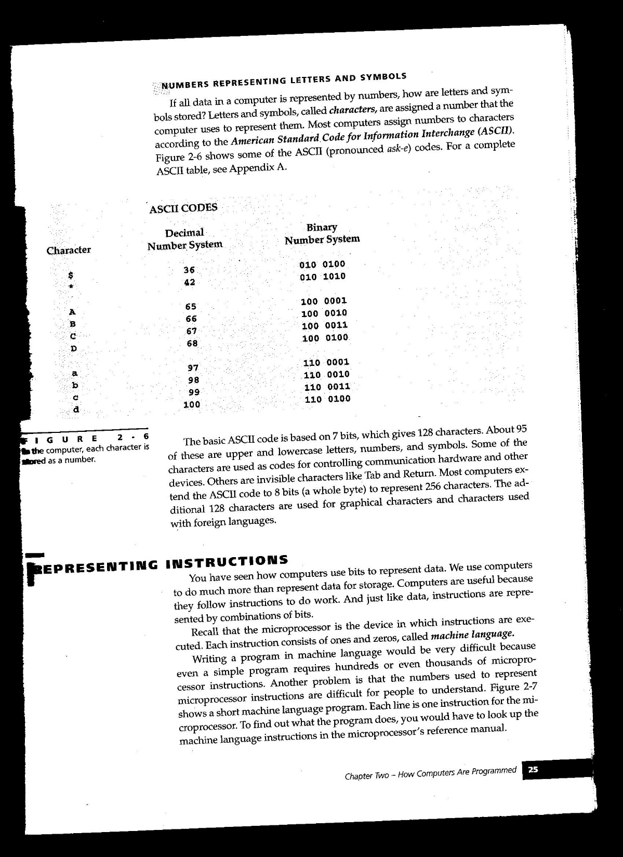

Slide 9
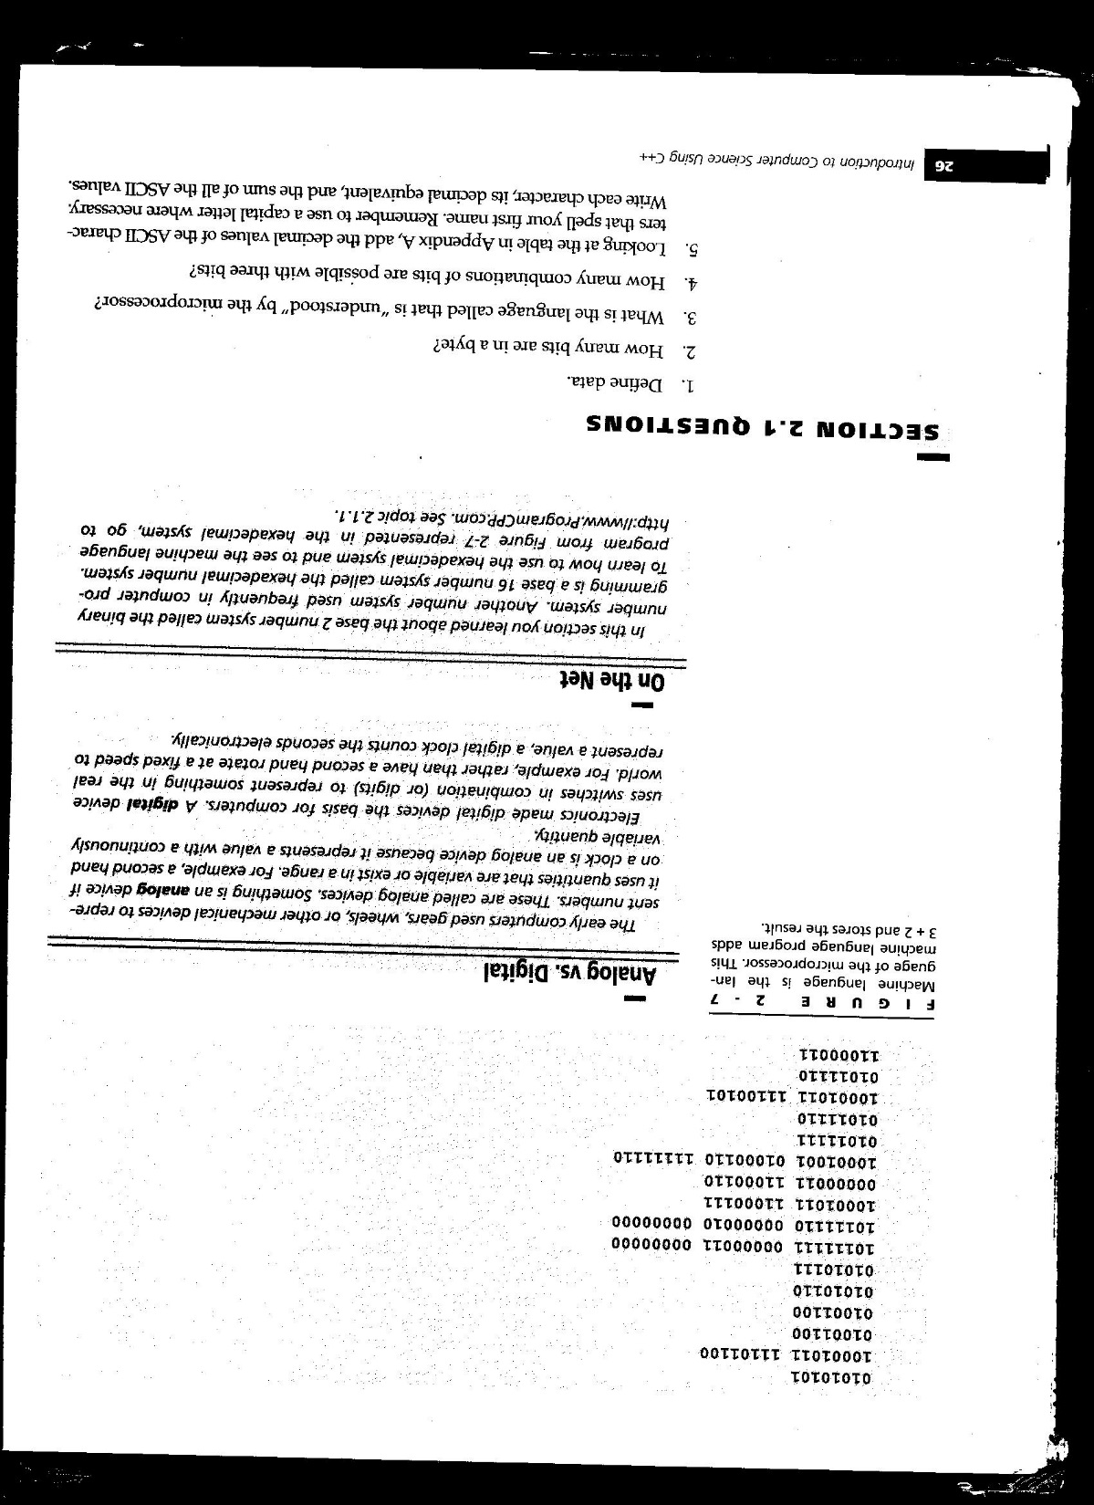

Slide 10
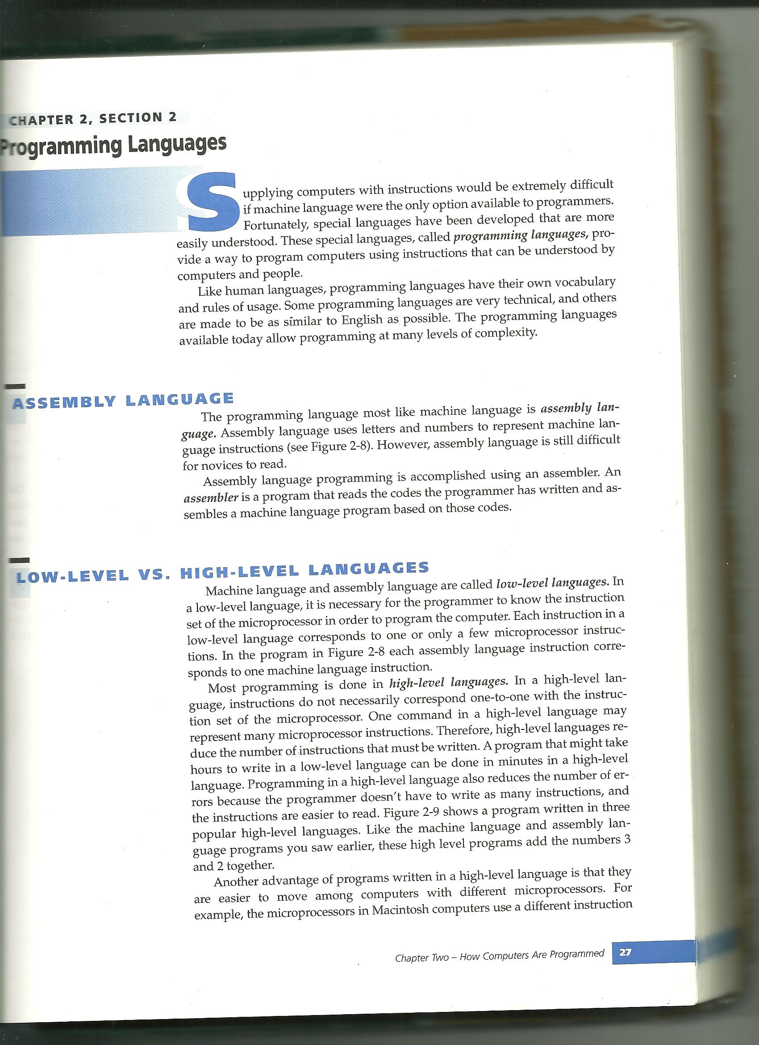

Slide 11
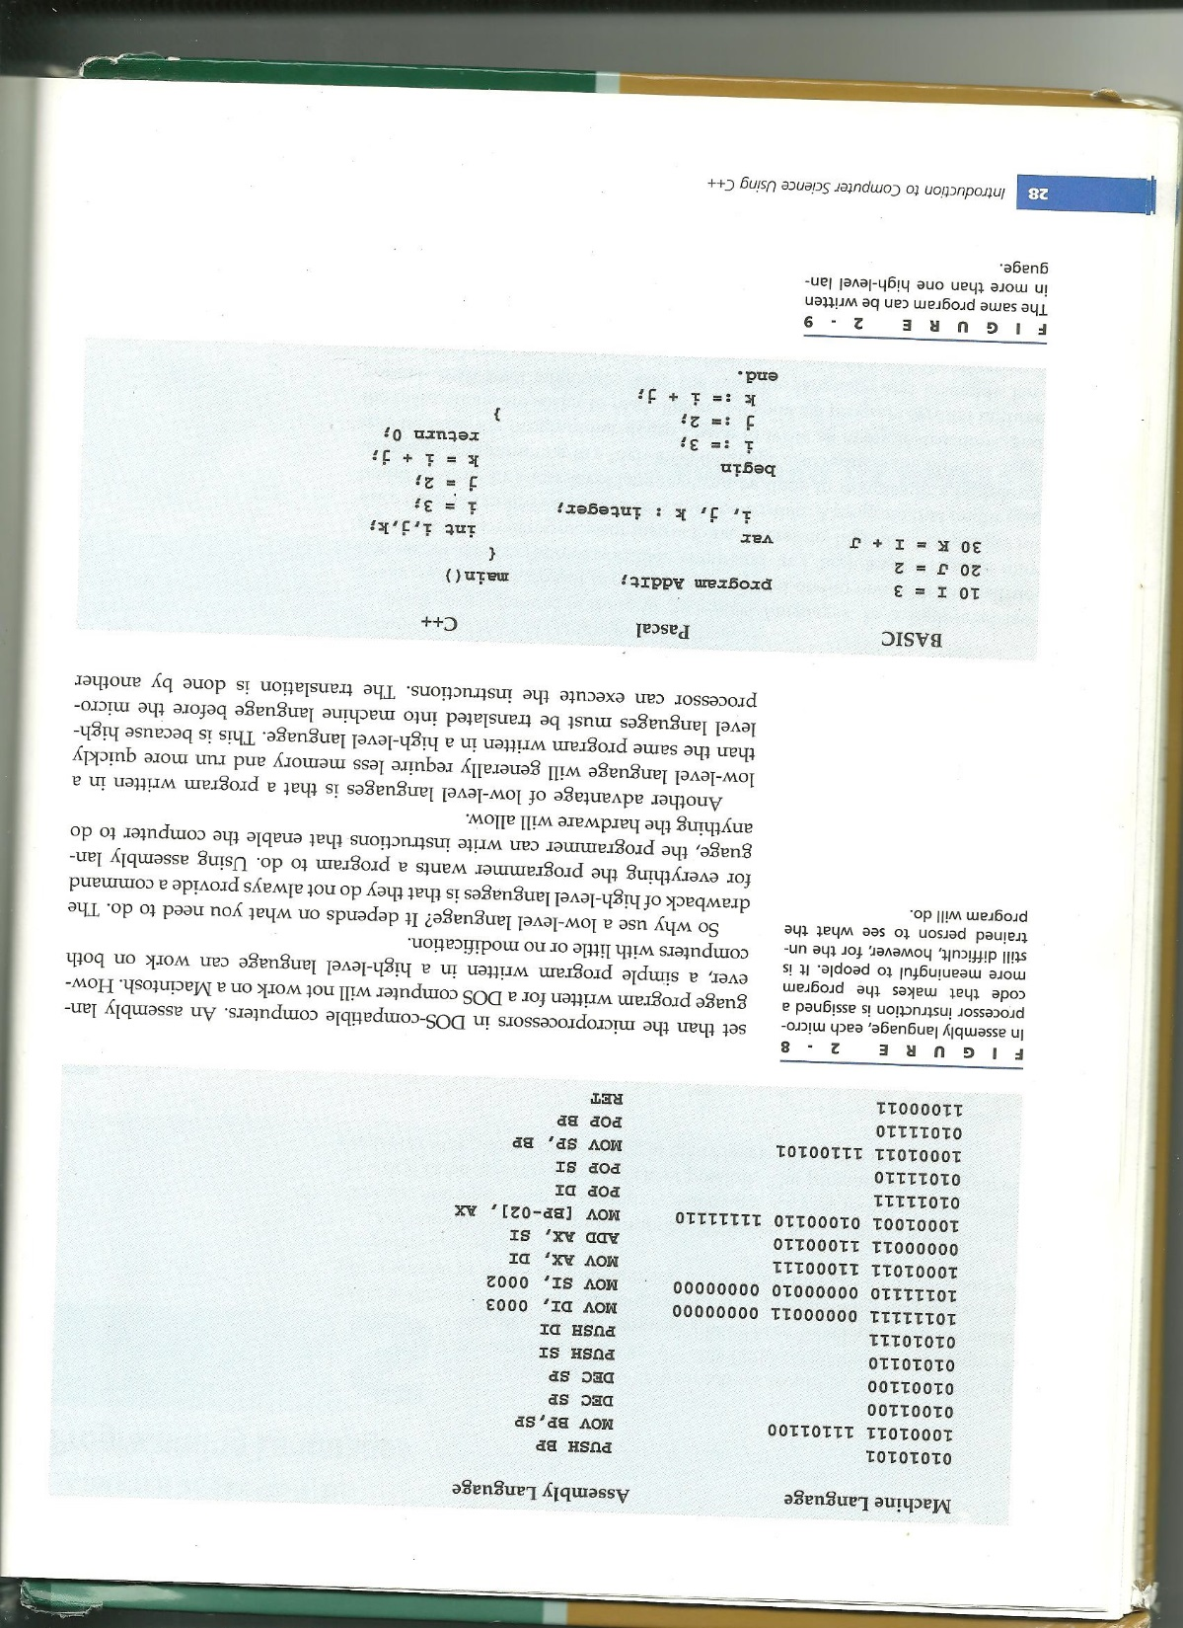
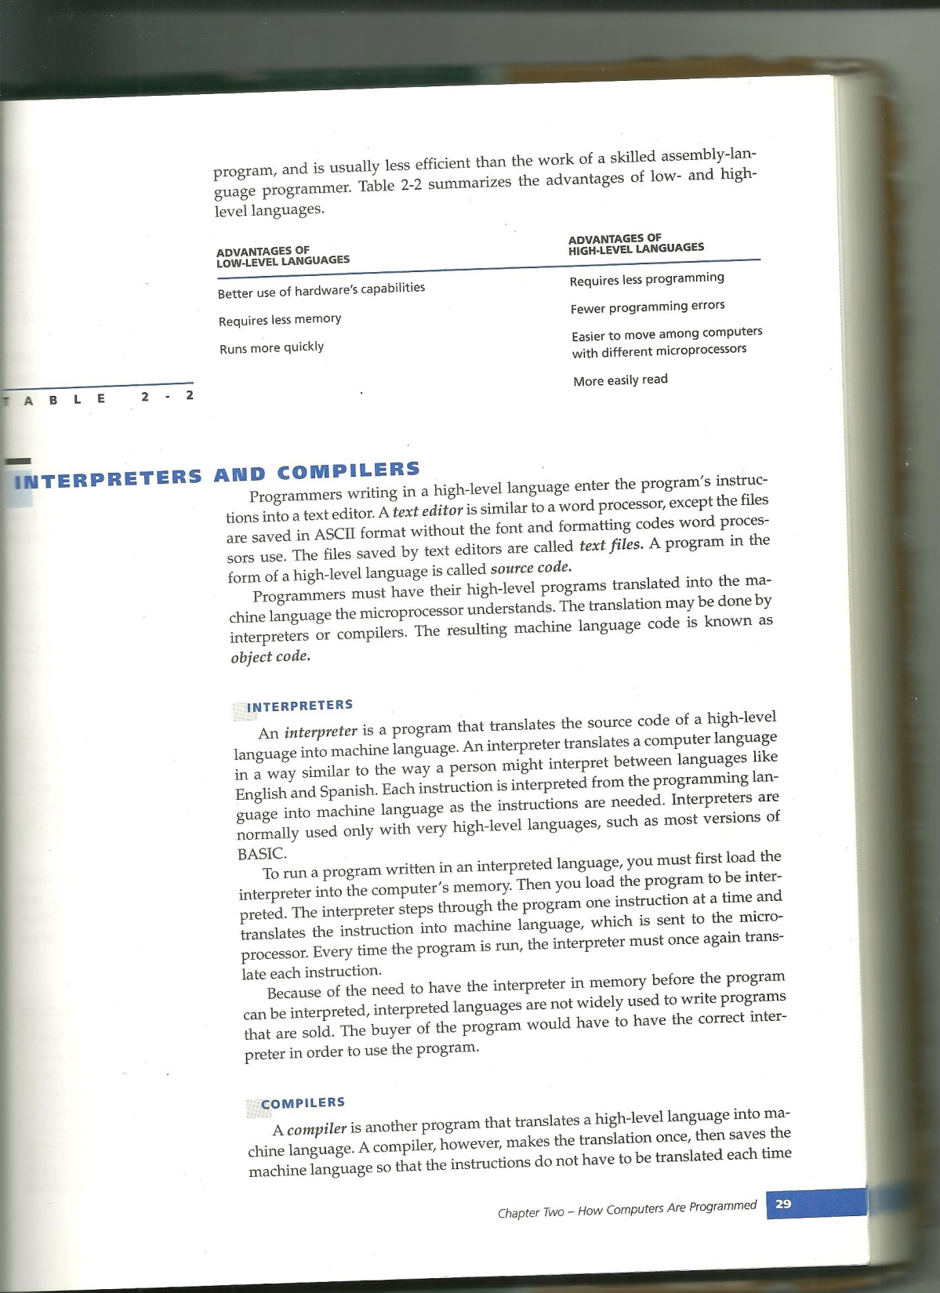

Slide 12
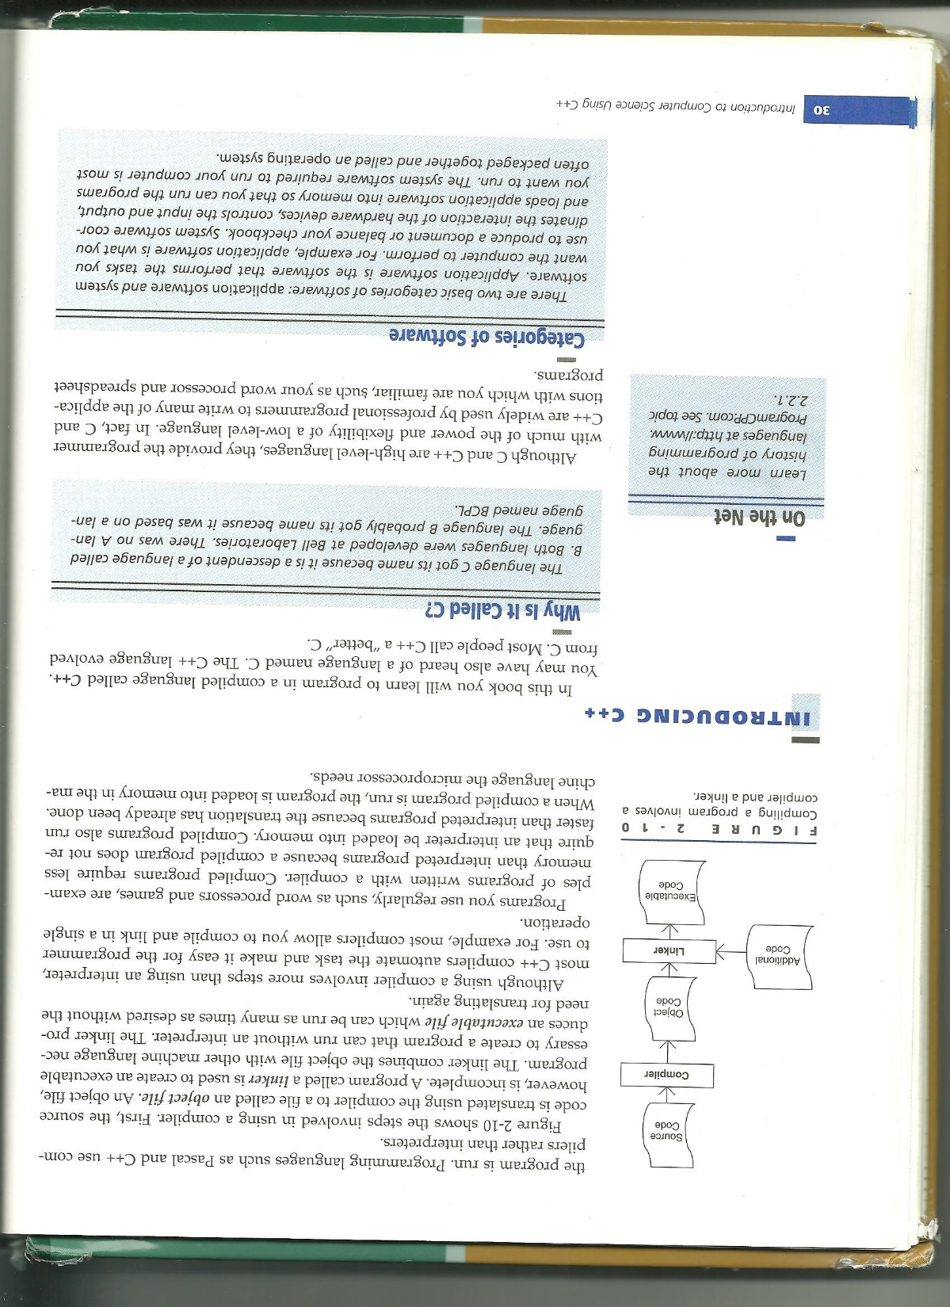
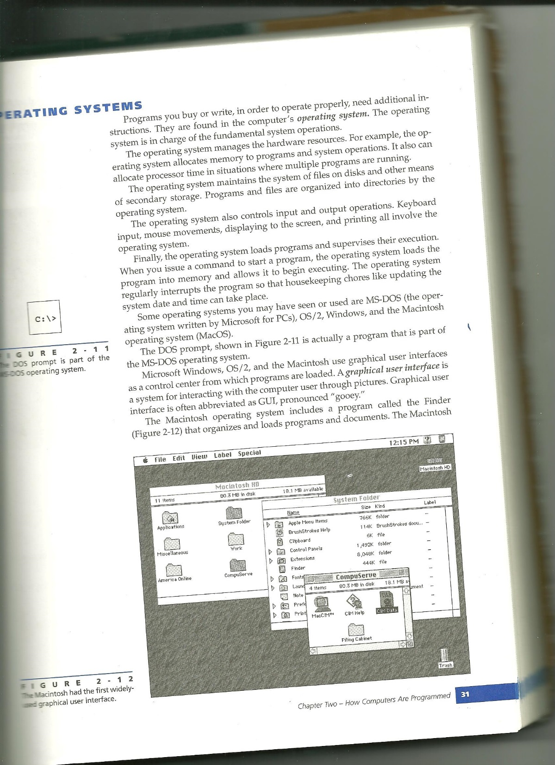

Slide 13
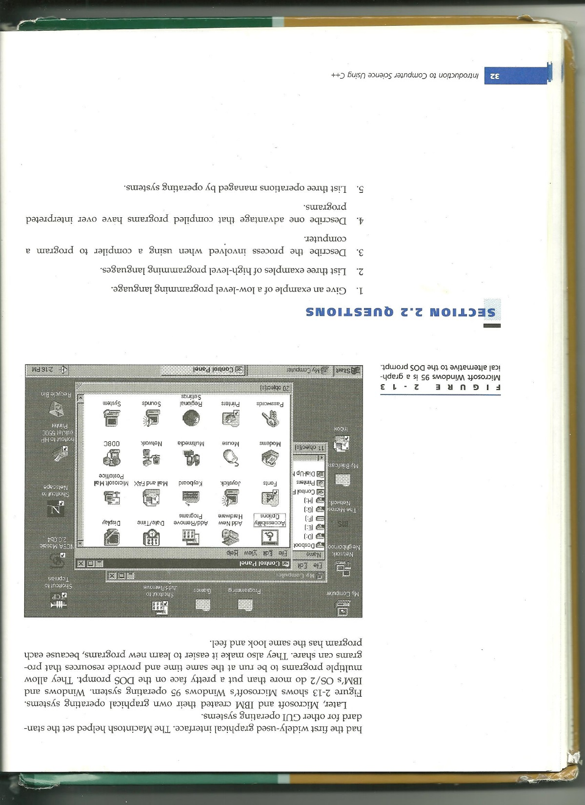
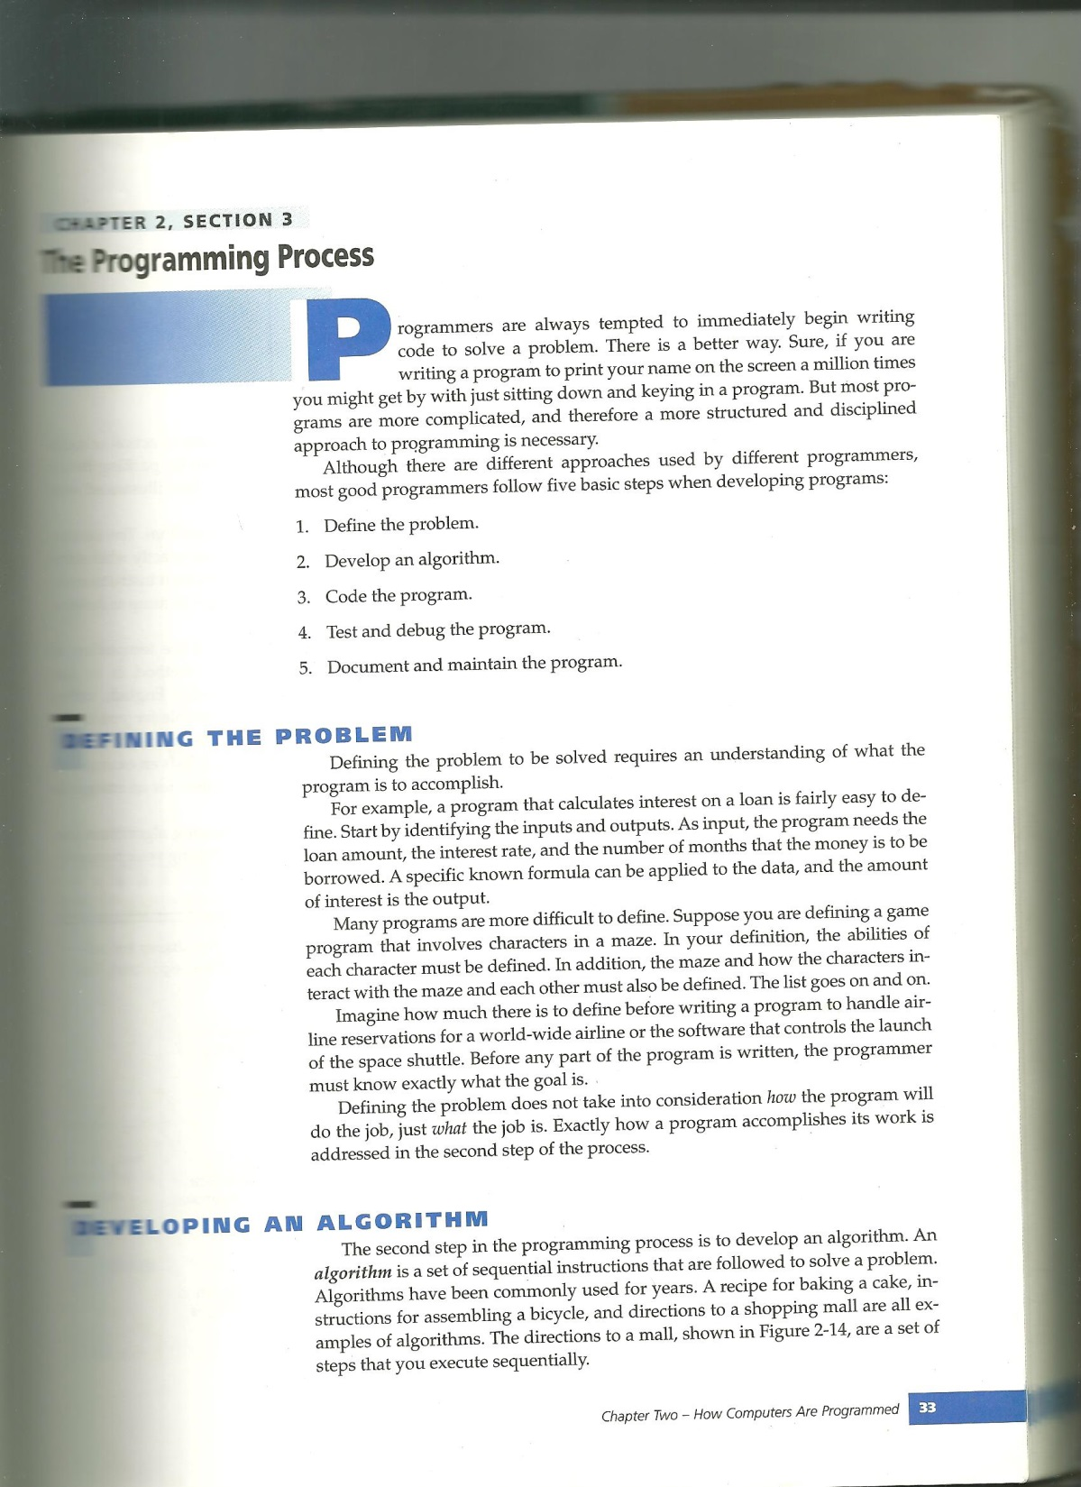

Slide 14
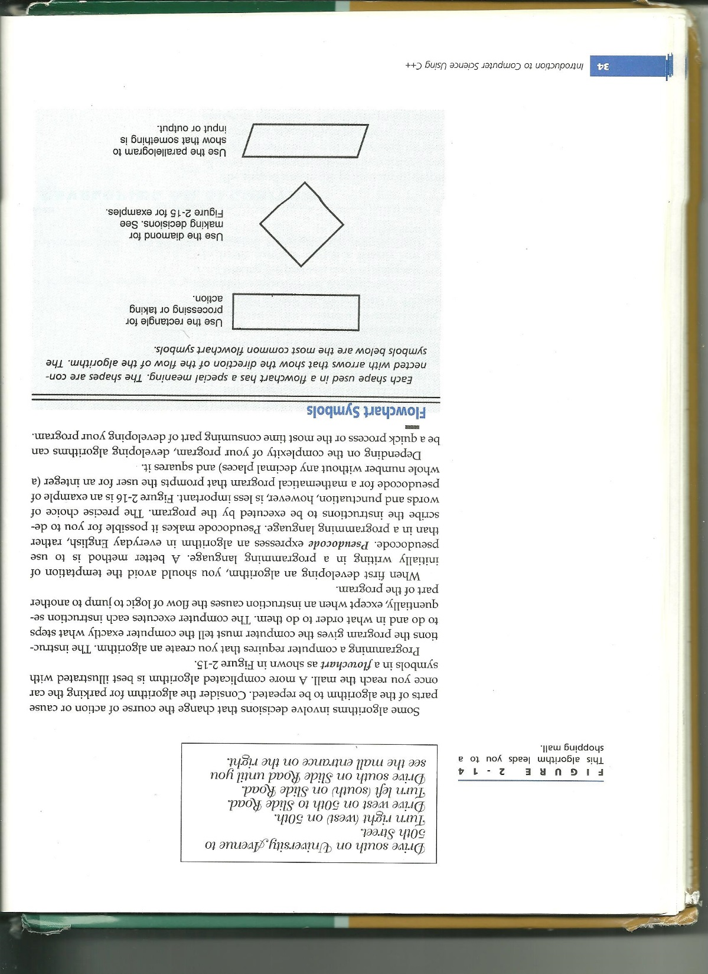
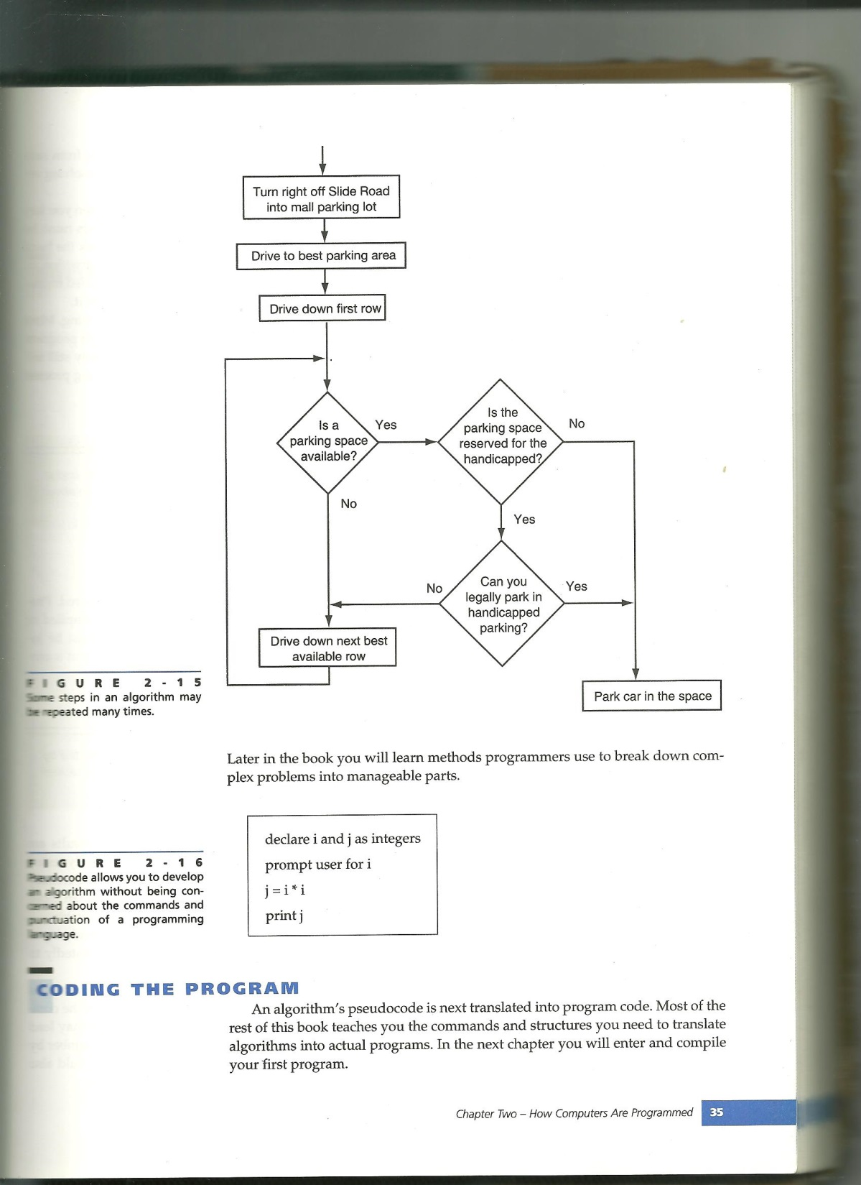

Slide 15
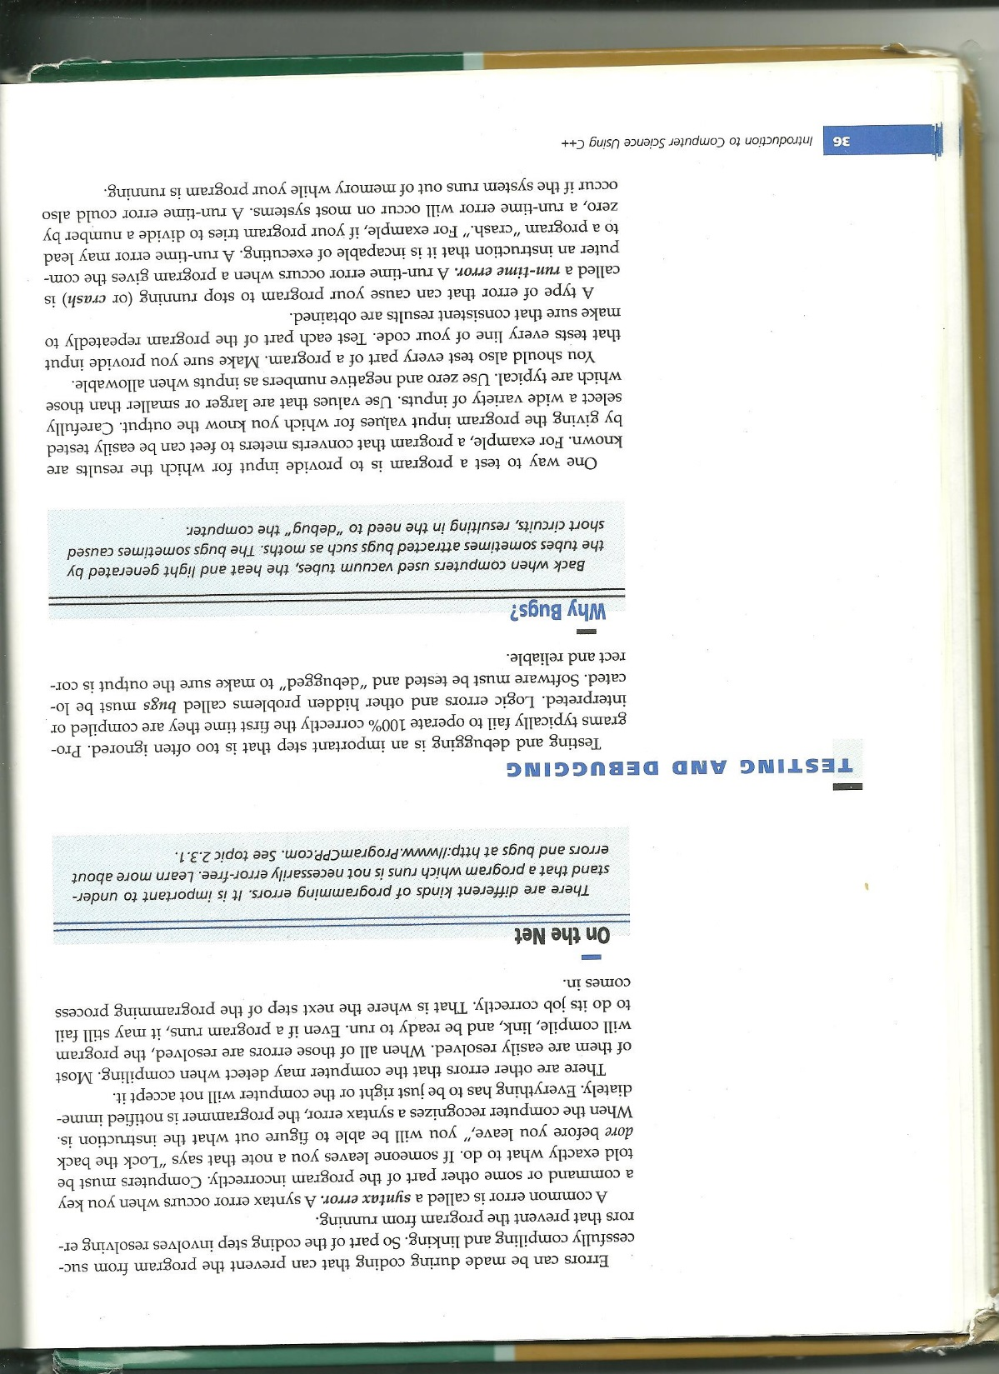
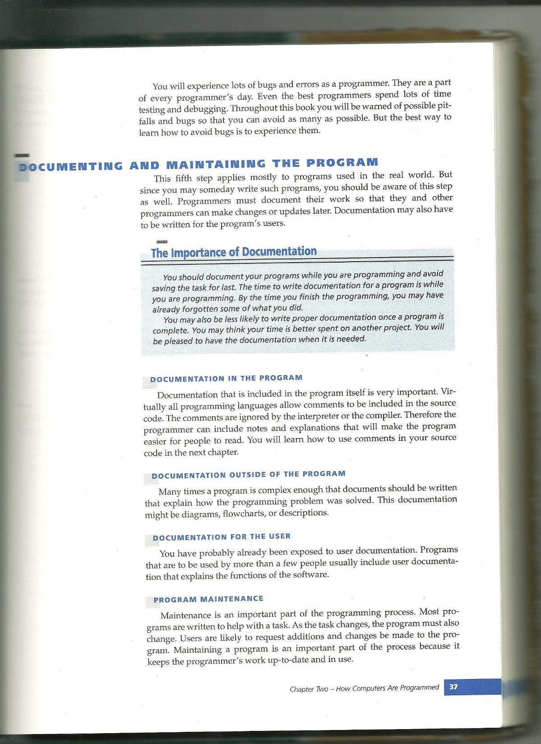

Slide 16
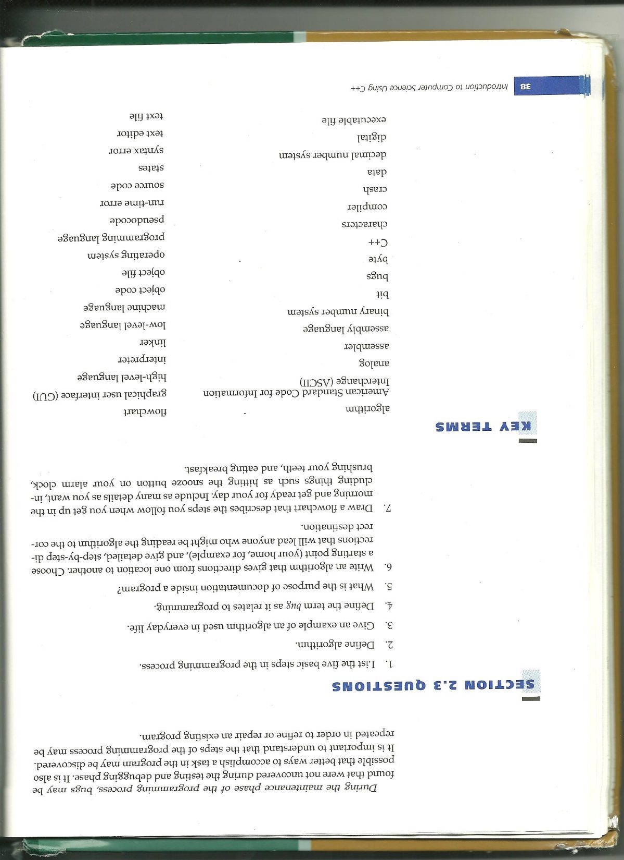
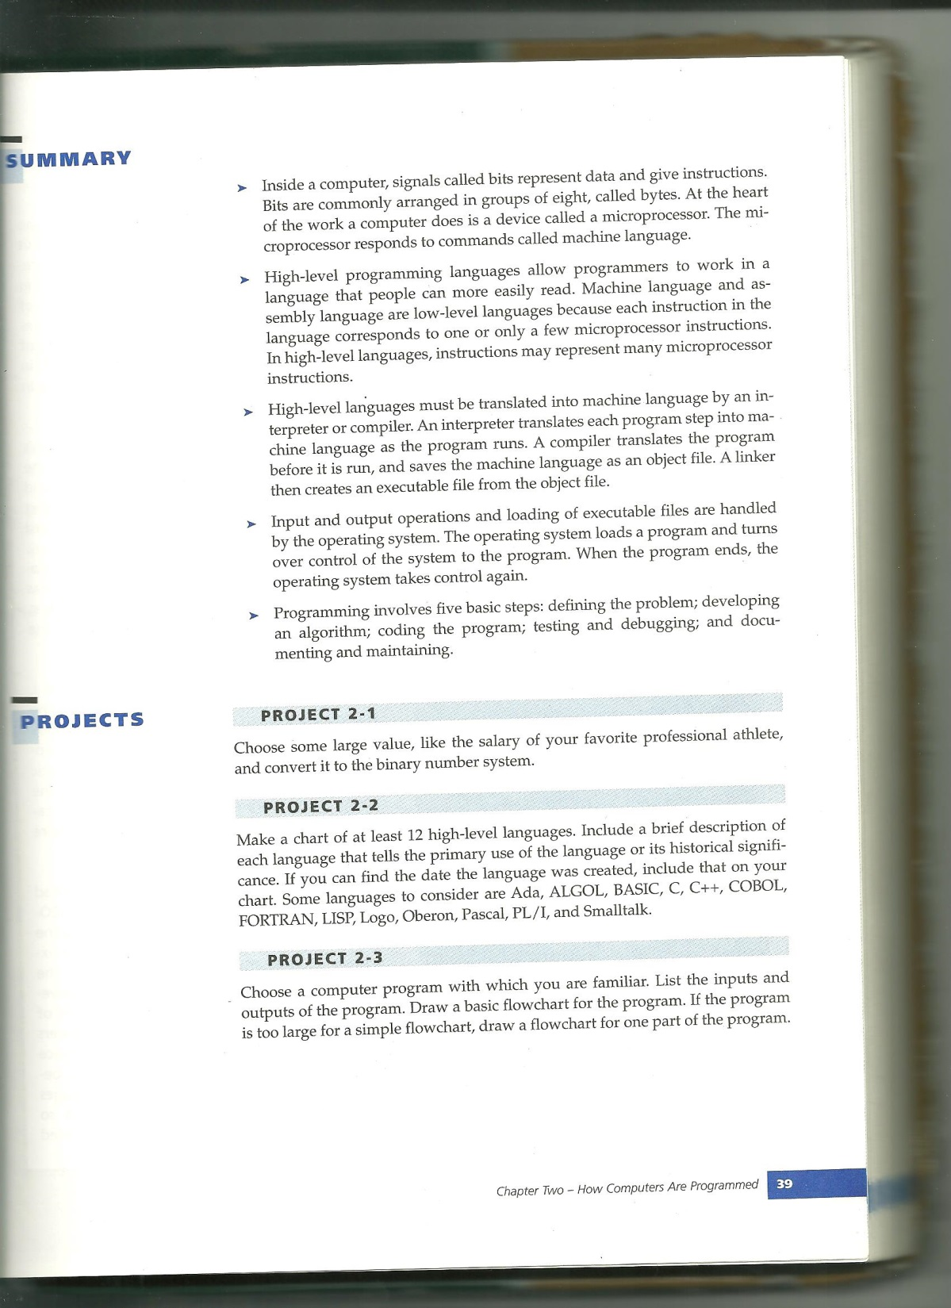

Slide 17
Chapter 3 Entering, compiling and running a program

Slide 18
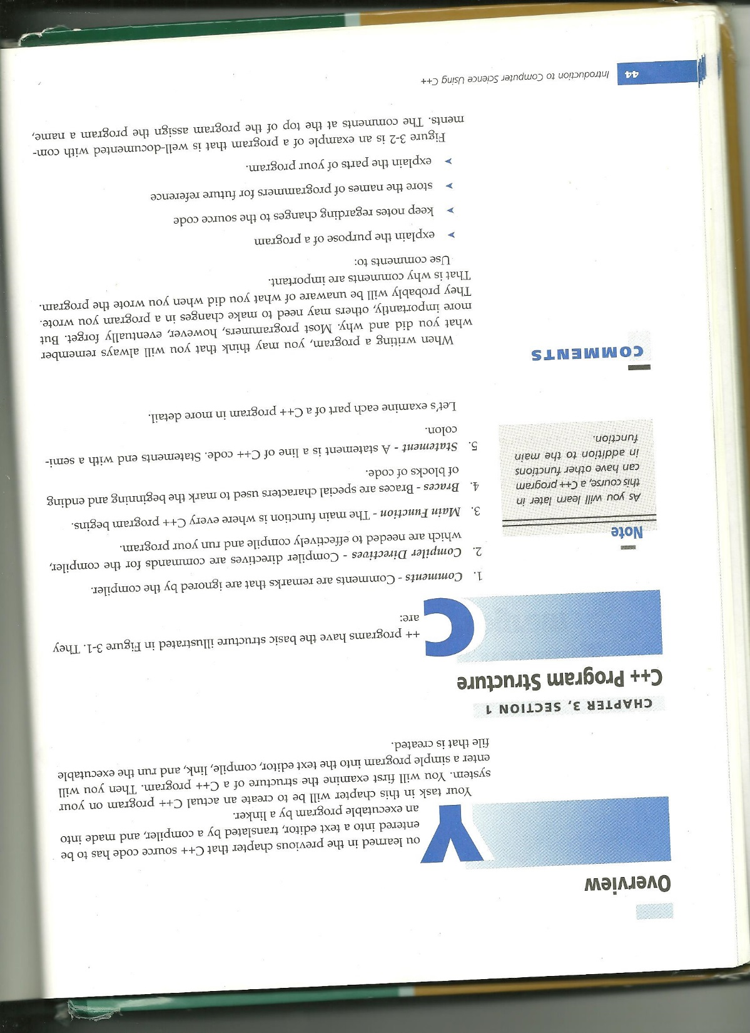
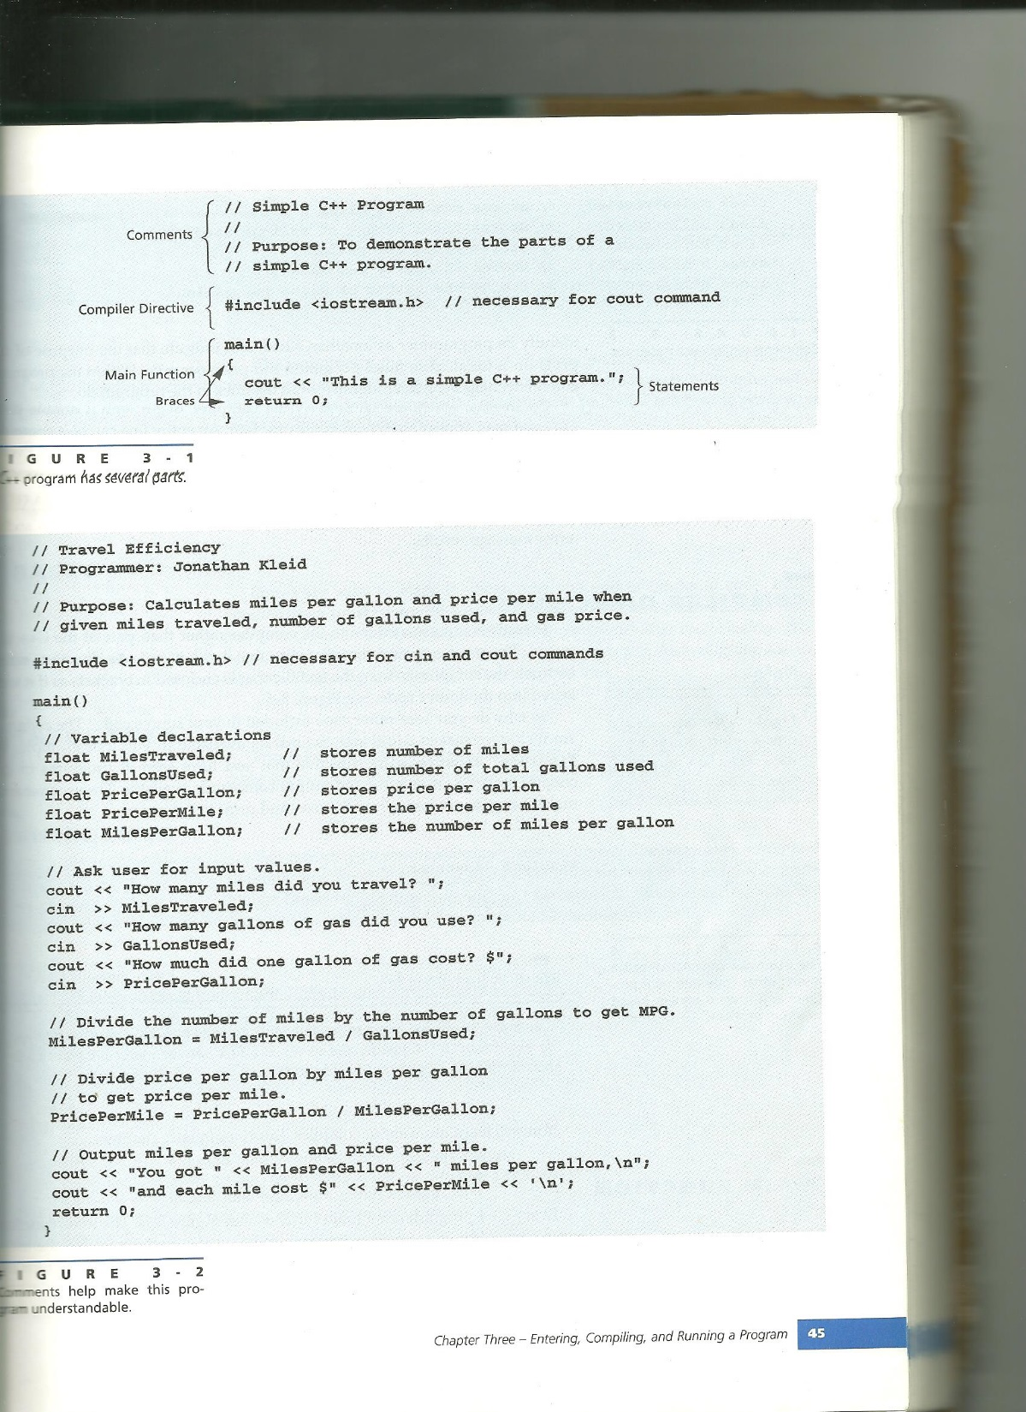

Slide 19
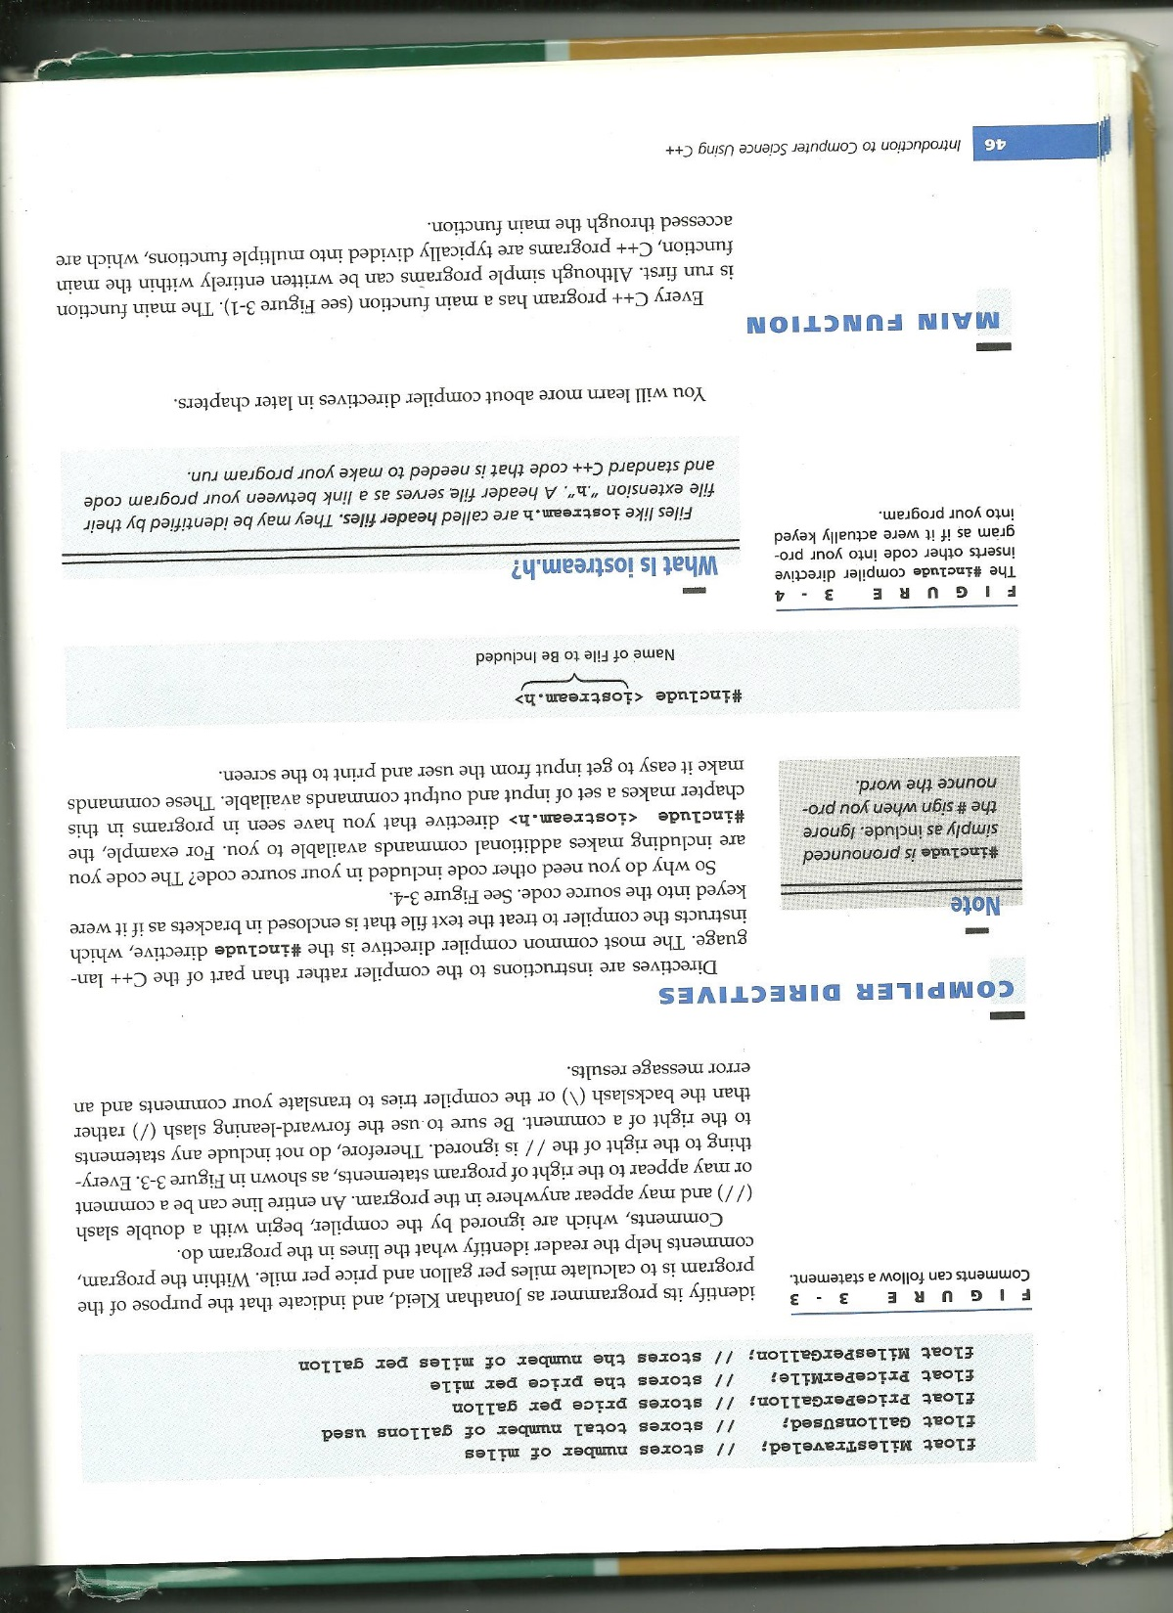
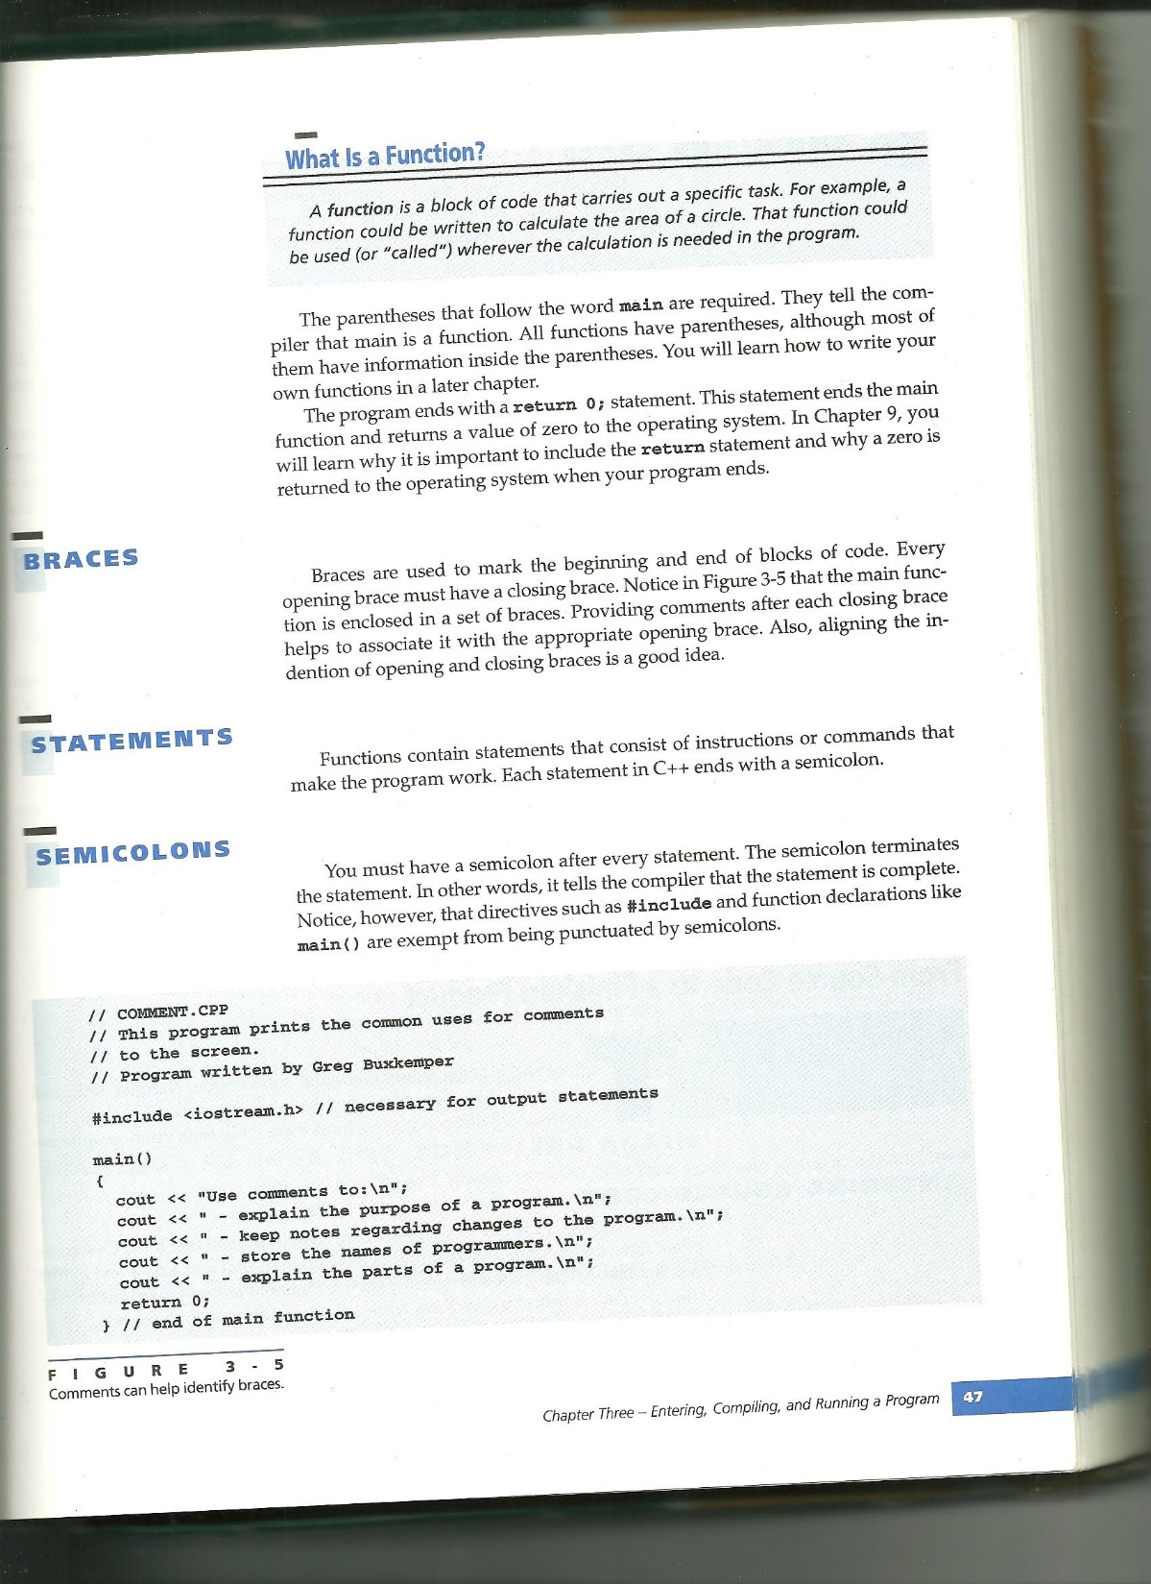

Slide 20
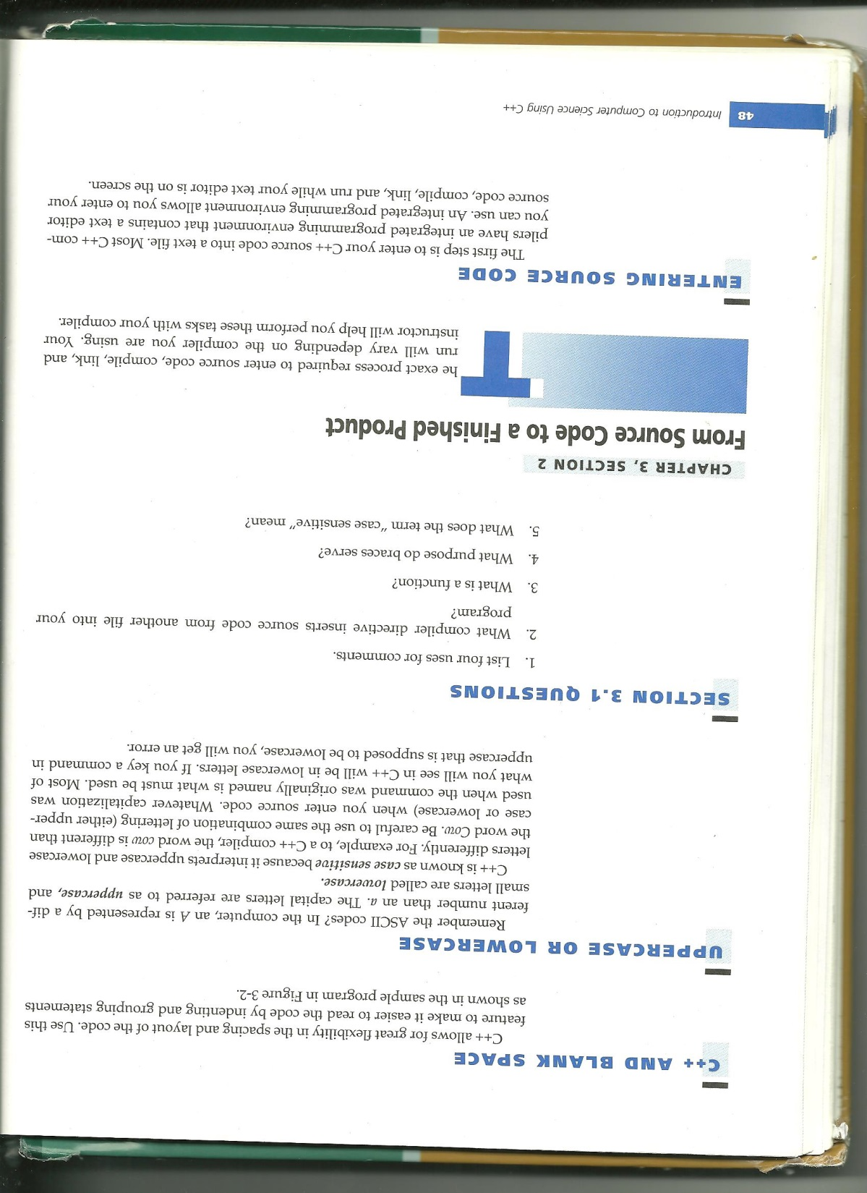
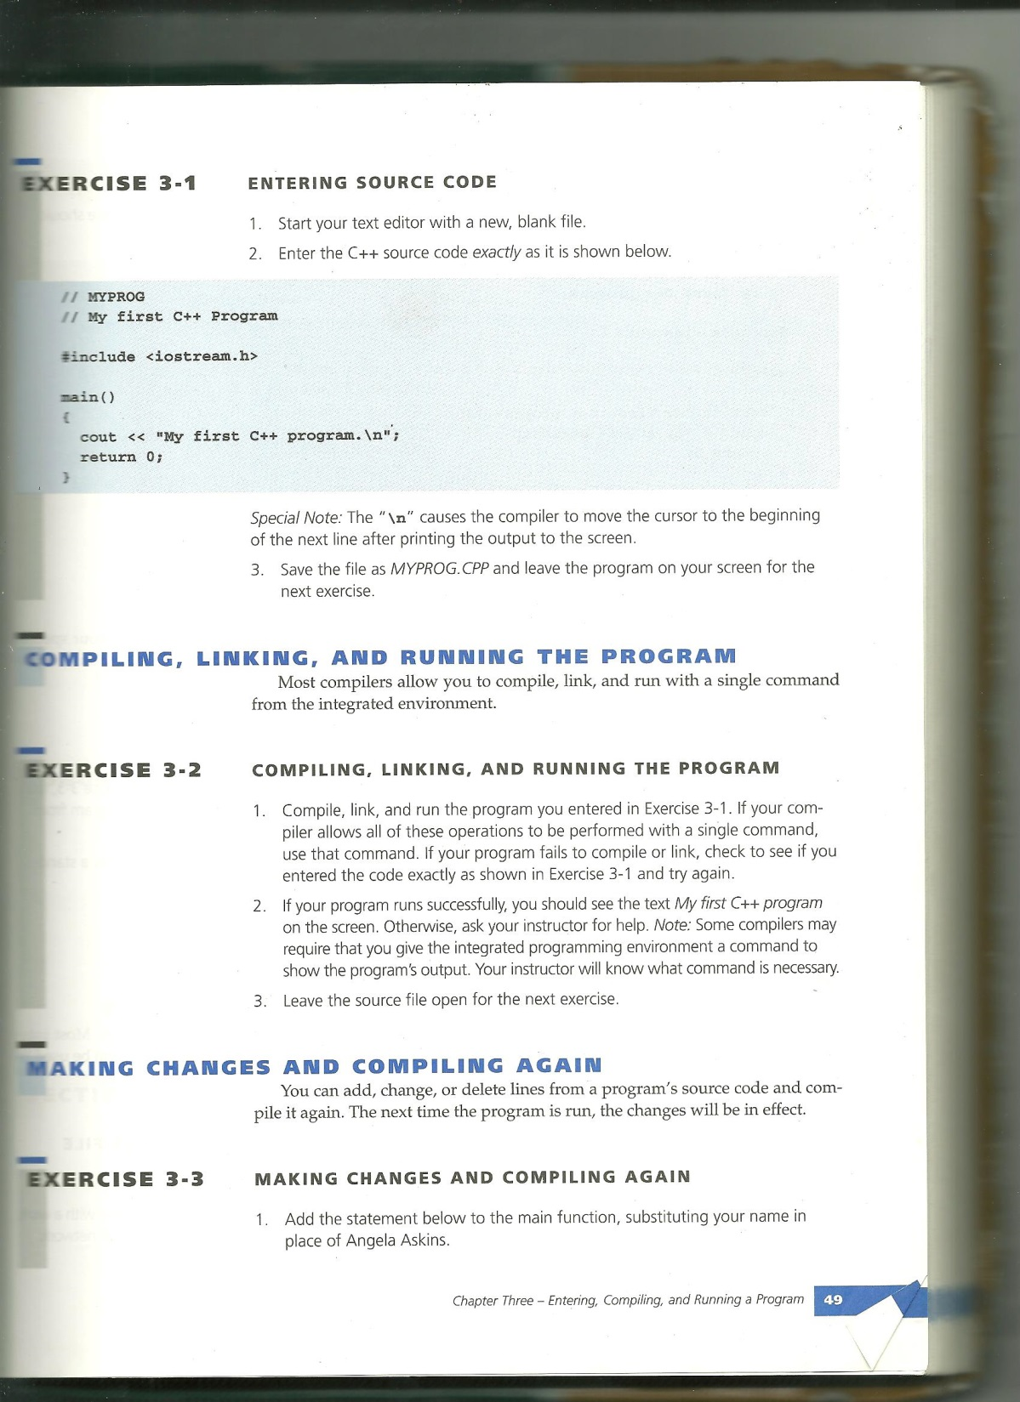

Slide 21
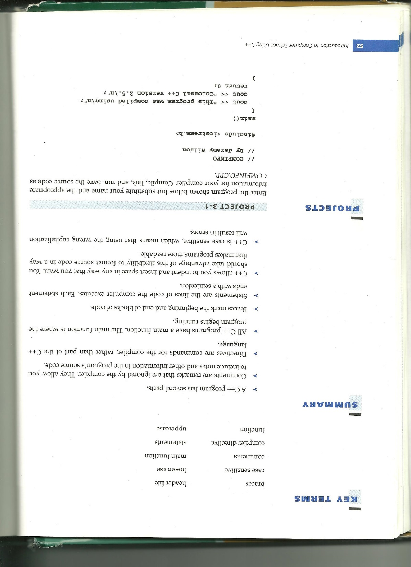
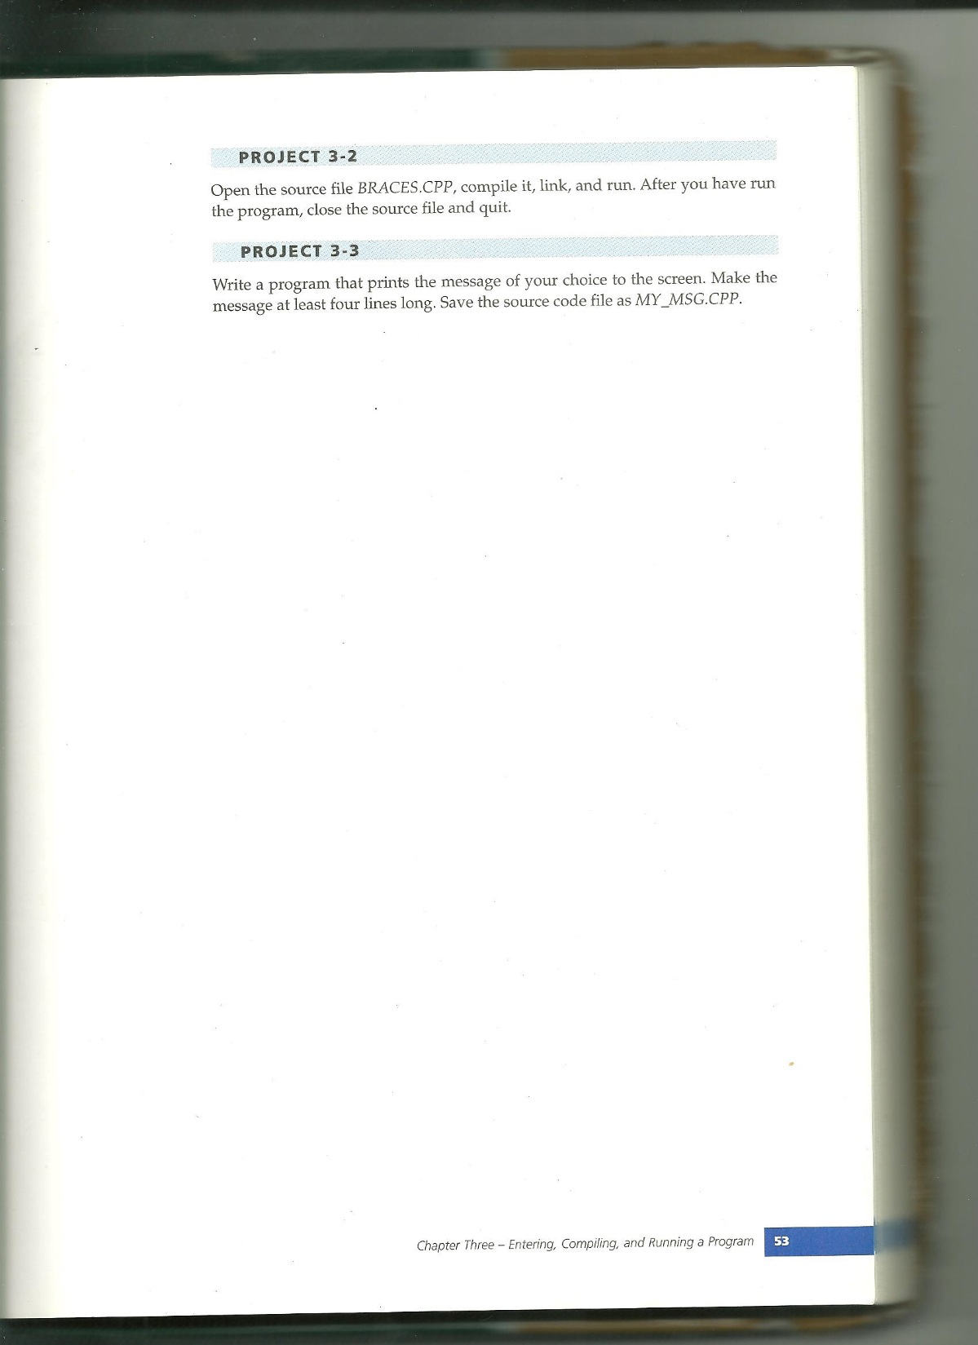

Slide 22
